Slide 1




Permanent 3D laser scanning system for an active landslide in Gresten (Austria) Canli, E.¹, Höfle, B.², Hämmerle, M.², Thiebes, B.^{1,3}, Glade, T.¹ ¹ University of Vienna (ekrem.canli@univie.ac.at), ² Heidelberg University, ³ EURAC research
1. Idea
3. Workflow
2. Installation
4. First Results
Navigation
Click buttons for more information
Enlarge pictures by clicking on it
Study site

Slide 2




Permanent 3D laser scanning system for an active landslide in Gresten (Austria) Canli, E.¹, Höfle, B.², Hämmerle, M.², Thiebes, B.^{1,3}, Glade, T.¹ ¹ University of Vienna (ekrem.canli@univie.ac.at), ² Heidelberg University, ³ EURAC research
1. Idea
3. Workflow
2. Installation
4. First Results
[Idea]
Terrestrial laser scanners (TLS) widely used for high spatial resolution data acquisition (landslides, rockfalls, debris flows, etc.)
Many advantages:
High spatial sampling density of XYZ-measurements (compared to low data density surface monitoring techniques; e.g. GNSS or total station)
mm accuracy/precision of measurement & cm accuracy of final DEM
Capability of highly dense area-wide scanning that enables to look through vegetation
Main constraints: low temporal resolution (labor costs, time requirements for field campaigns) --> only episodical repetition measurements (e.g. once per year)
To gain an increased scientific understanding of a process, we present a novel permanent 3D monitoring setup to increase the temporal resolution of TLS measurements (pTLS)
Navigation
Click buttons for more information
Enlarge pictures by clicking on it
Study site
Notes:
BENNI: pTLS steht für „permanent TLS“…das vllt explizit erwähnen – wär cool, wenn sich dieser Begriff etablieren könnte

Slide 3
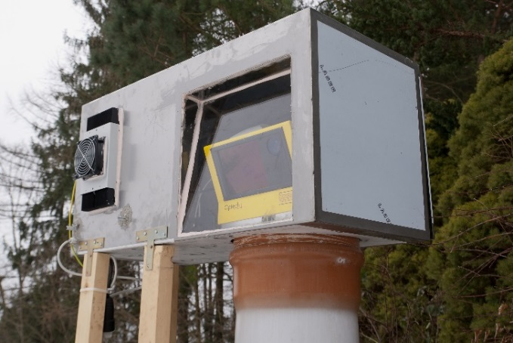
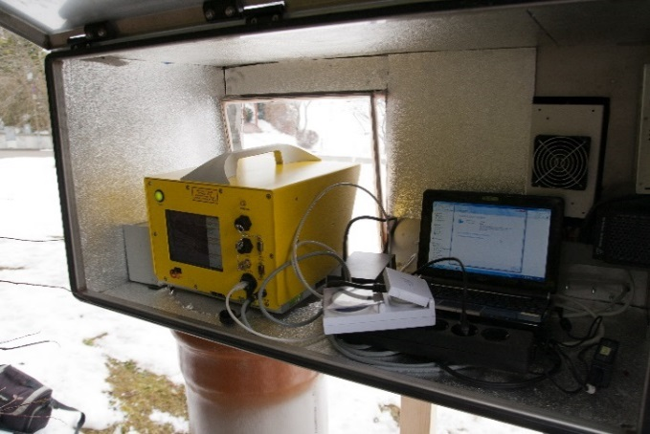
Permanent 3D laser scanning system for an active landslide in Gresten (Austria) Canli, E.¹, Höfle, B.², Hämmerle, M.², Thiebes, B.^{1,3}, Glade, T.¹ ¹ University of Vienna (ekrem.canli@univie.ac.at), ² Heidelberg University, ³ EURAC research
1. Idea
3. Workflow
2. Installation
4. First Results
[Installation]
Optech ILRIS-3D scanner mounted on massive surveying pillar
Encased in custom made protective box
Permanent connection to power supply and internet
Isolated; cooler/heater
Optical glass; prevents reflections, high (near) infrared transmissivity
Field of view (FoV) from the fixed scanner position covers most of the active landslide surface (with a maximum distance of ca. 300 m)
Navigation
Click buttons for more information
Enlarge pictures by clicking on it
Study site

Slide 4
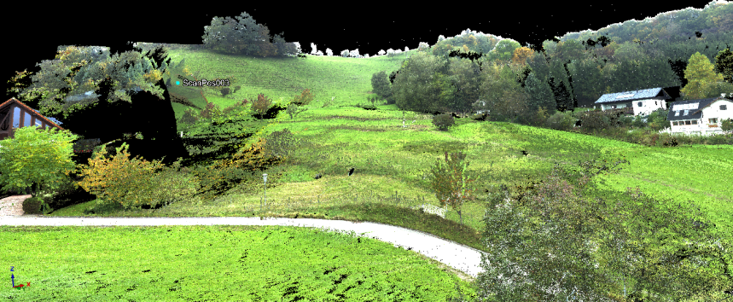
Permanent 3D laser scanning system for an active landslide in Gresten (Austria) Canli, E.¹, Höfle, B.², Hämmerle, M.², Thiebes, B.^{1,3}, Glade, T.¹ ¹ University of Vienna (ekrem.canli@univie.ac.at), ² Heidelberg University, ³ EURAC research
1. Idea
3. Workflow
2. Installation
4. First Results
[Workflow]
pTLS autonomously operated by time switch and scripts
Performs 1 scan/day; data transmission via internet to server in Vienna
Each scan contains XYZ (+intensity) ASCII file, coloured picture, and scan metadata
Single independent scan with a Riegl VZ-6000 acts as reference measurement (global coordinate system GCS, i.e. UTM/WGS84)
pTLS scans (scanner own coord. system) are automatically transformed into the GCS with 3D-transformation using matching of corresponding point pair coordinates of tie reflectors
Derivation of Digital Elevation Models (DEM): Digital Terrain Model (DTM), Digital Surface Model (DSM)
Calculation of Difference Models (raster/point cloud): daily, weekly, annually, and for selected time intervals
Navigation
Click buttons for more information
Enlarge pictures by clicking on it
XYZ + Intensity + RGB
Point Clouds
Study site
Notes:
[BENNI: point pairs sind so kleine Reflektorscheiben außerhalb der Rutschung, die mit dem Tachy eingemessen wurden)

Slide 5
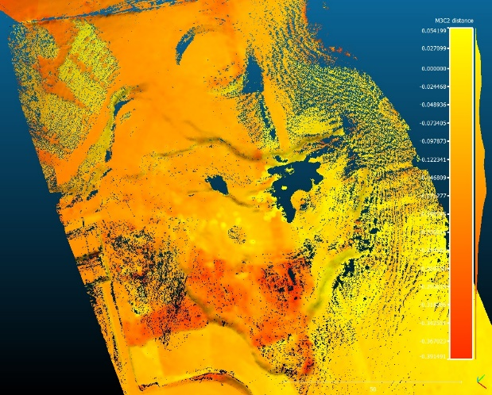
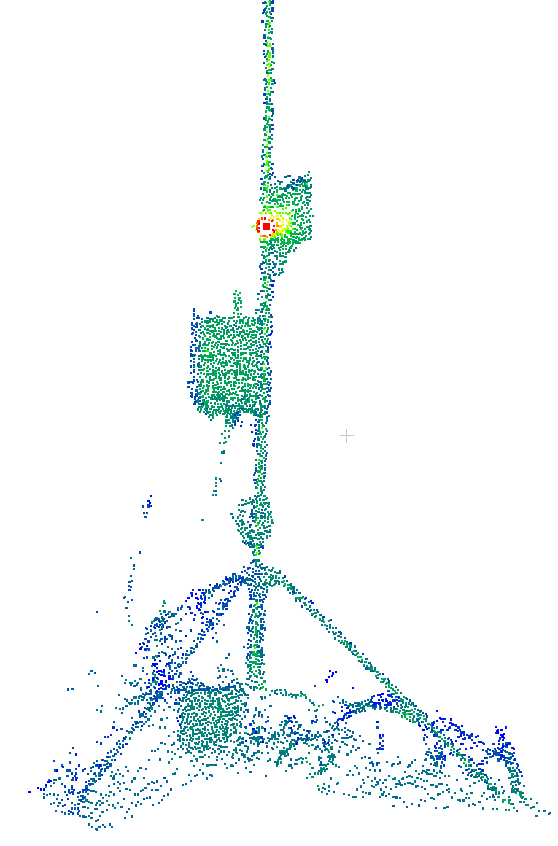
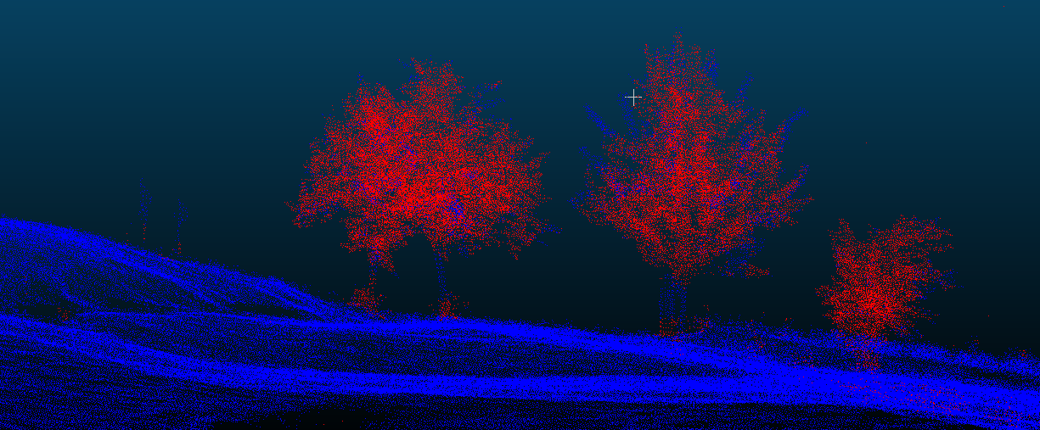
Permanent 3D laser scanning system for an active landslide in Gresten (Austria) Canli, E.¹, Höfle, B.², Hämmerle, M.², Thiebes, B.^{1,3}, Glade, T.¹ ¹ University of Vienna (ekrem.canli@univie.ac.at), ² Heidelberg University, ³ EURAC research
1. Idea
3. Workflow
2. Installation
4. First Results
[First Results]
48 daily datasets already captured with approx. 1.3 billion points in total
Next steps
Implementation of web tool to derive descriptive statistics and time series plots of changes in near-realtime (i.e. before next scan)
Improvement of terrain classification by including point cloud time series (not just taking one point cloud for classification)
Intensity-based detection of tie reflectors for georeferencing
Cloud-to-Cloud Difference (M3C2)
Navigation
Click buttons for more information
Enlarge pictures by clicking on it
Terrain filtering (DTM)
Study site

Slide 6



[close]

Slide 7

[close]

Slide 8
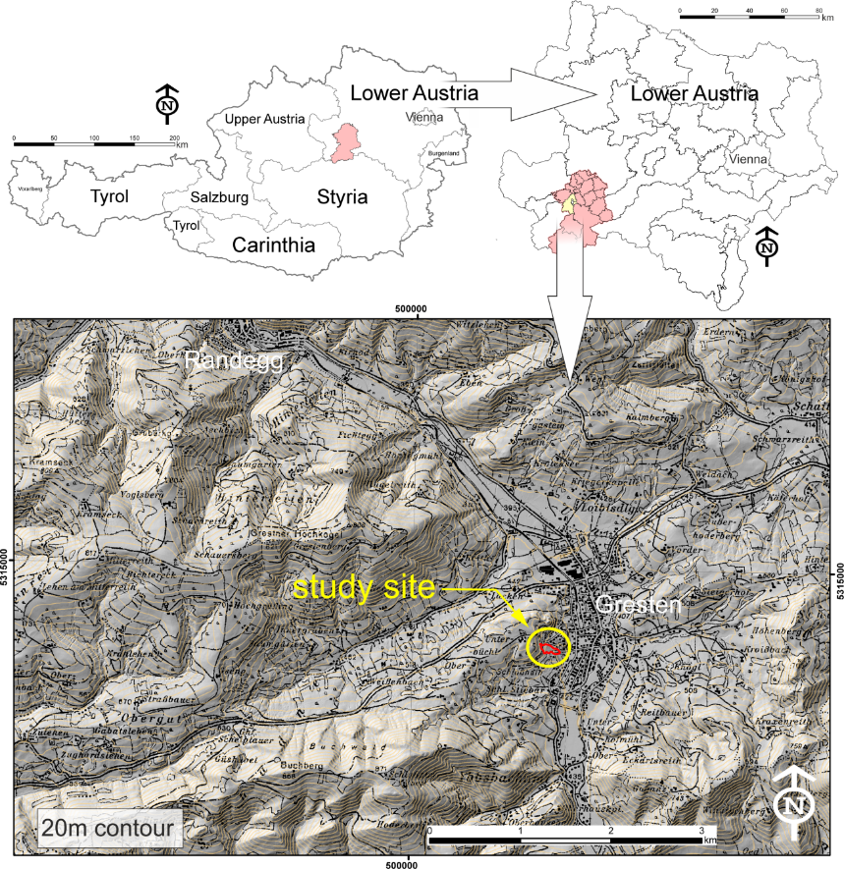
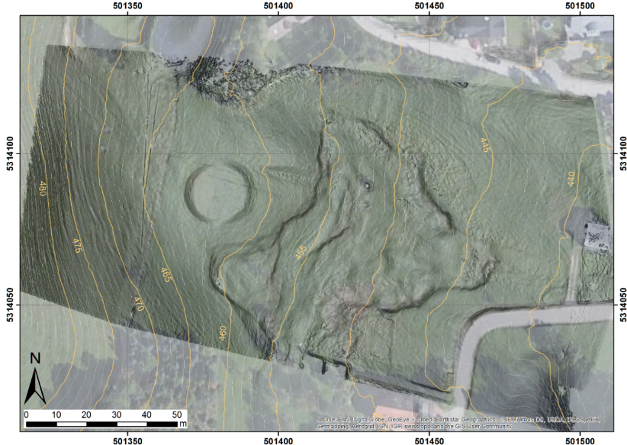
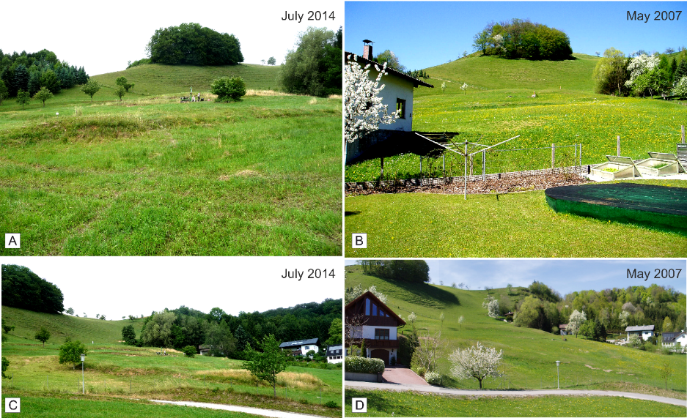
Permanent 3D laser scanning system for an active landslide in Gresten (Austria) Canli, E.¹, Höfle, B.², Hämmerle, M.², Thiebes, B.^{1,3}, Glade, T.¹ ¹ University of Vienna (ekrem.canli@univie.ac.at), ² Heidelberg University, ³ EURAC research
1. Idea
3. Workflow
2. Installation
4. First Results
[Study site]
Salcher landslide in Gresten (Lower Austria)
Navigation
Click buttons for more information
Enlarge pictures by clicking on it
Slow moving, mainly translational landslide
Situated in the Austrian Pre-Alps (transition zone between Flyschzone and Klippenbelt)
Varying movement rates; up to 20 cm/a
Initial movements reported in July 1975
pTLS pos.
also: EGU2015-223
Canli et al.: „Multi-parameter monitoring of a slow moving landslide in Gresten (Austria)“
Session NH3.4, room G1, Wed., 15. Apr 2015, 08:30

Slide 9
[close]

Slide 10
[close]

Slide 11
[close]
pTLS pos.

